Slide 1

Shopzilla Site Redesign – We get what we measure
Phil Dixon, VP Engineering
Velocity 2009
June 23rd, 2009 | Velocity 2009

Slide 2



Shopzilla, Inc. - Online Shopping Network
100M
impressions/day
8,000+
searches per second
20-29M
UV’s per Month
100M+
Products

Slide 3
Background
In 2000, the business was simple - bizrate.com in the US
Co-brands, API and shopzilla.com
Multivariate testing, Europe and multiple data centers
Always in a rush
Difficult to change, differentiate
Site had become slow → between 4-6 second page loads

Slide 4
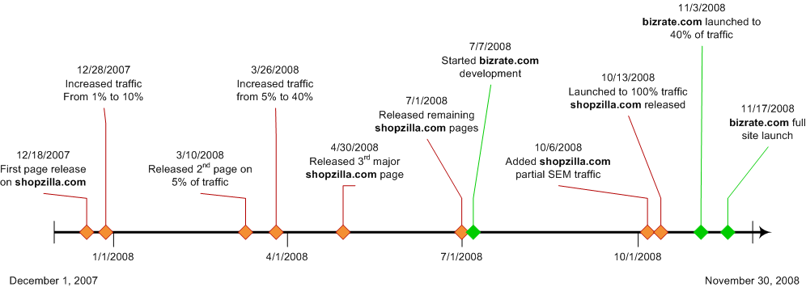
Our Build Approach
Start over, stay simple
Build 2 weeks at a time, deliver every page ASAP
Manage risk by managing exposure
Notes:
had to decide between “refactoring” and “rebuilding”
decided that we had a fundamentally different business, needed fundamentally different software
bizrate.com in the US. Then shopzilla.com and 10’s of cobrands. Then several countries/brands in europe
layered on desire to customize experience and a/b test

Slide 5
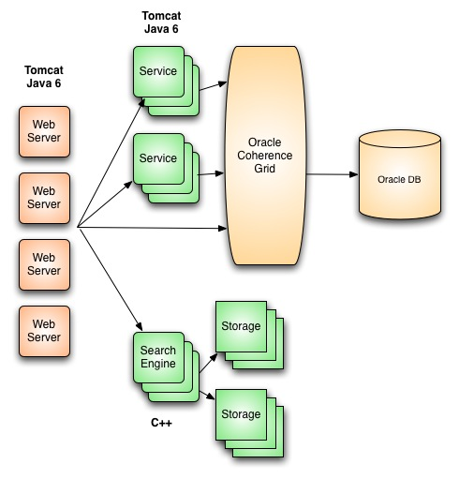
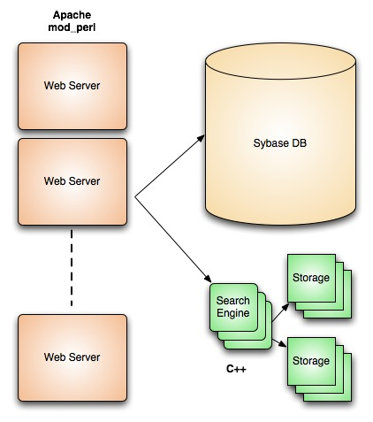
Shopzilla Site Technology Overview

Slide 6
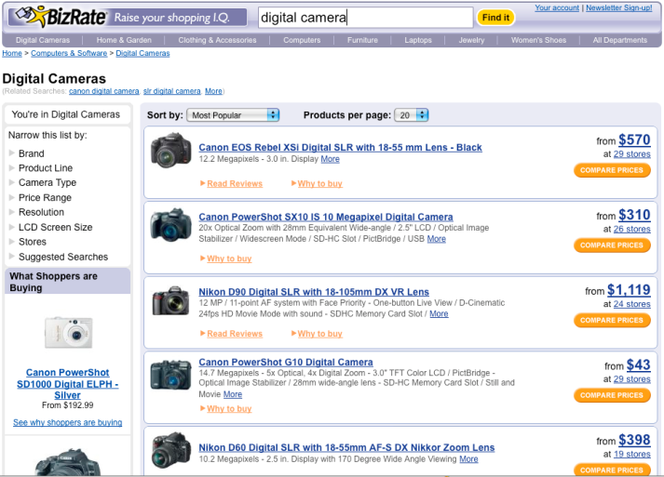
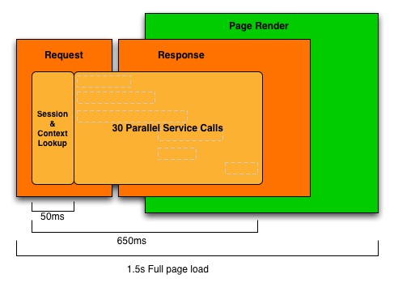
Anatomy of a Page Request

Slide 7
digitalcameras.bizrate.com – Server Side

Slide 8
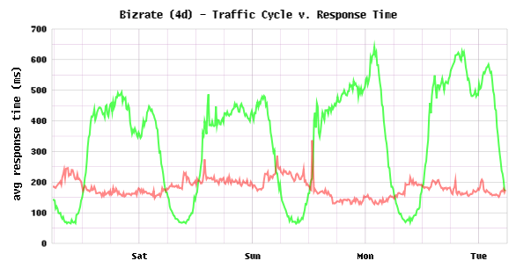
SLA’s – Key to High Performance
650ms server side
1.5s user experience
At the 95th percentile
Under peak loads
0% error rate

Slide 9
Most Performance Gains in the Browser
Images to non-cookie domain resulted in
0.5% top line revenue increase!

Slide 10
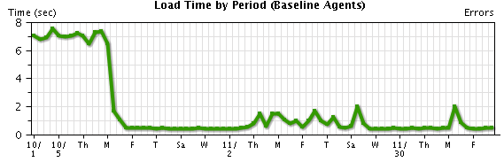
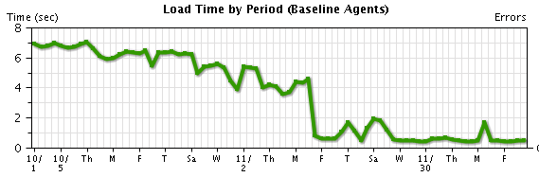
Can you spot our release dates?
shopzilla.com 10/13/08
bizrate.com 10/17/08

Slide 11
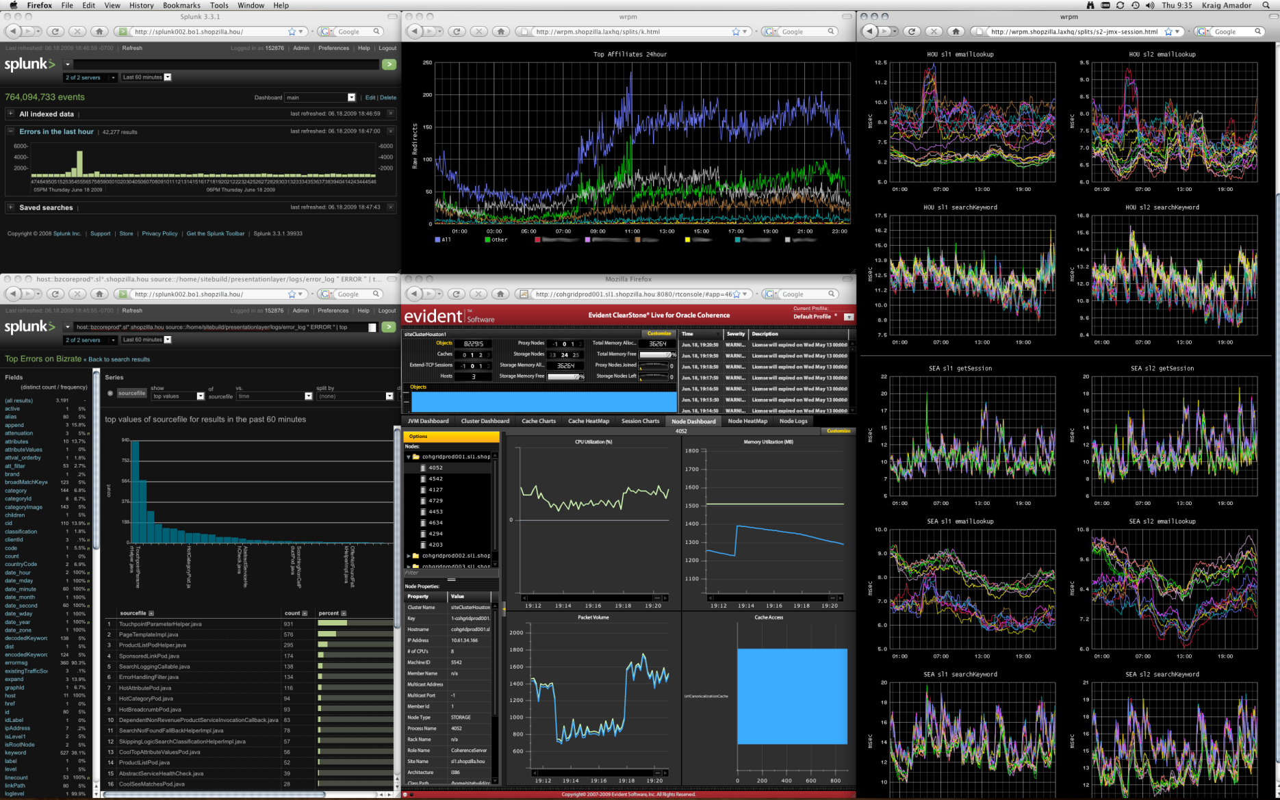
Gratuitous Graph Slide

Slide 12
Yeah, yeah… but did we make money?

Slide 13
Site conversion rates increased 7-12%
Revenue = sessions x conversion % x CPC

Slide 14
Performance Impacts Abandonment

Slide 15
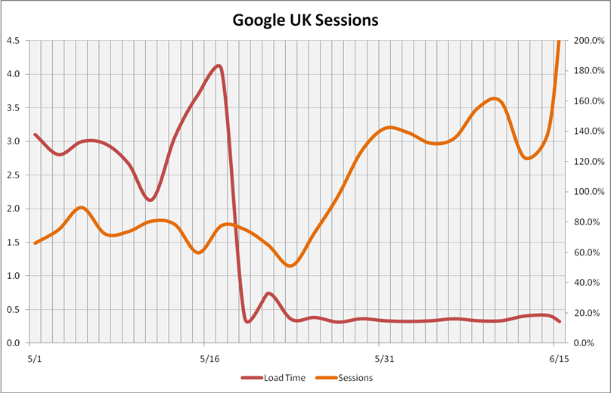
Performance Penalties & bizrate.co.uk
~120% SEM
Sessions

Slide 16
Performance Summary
Conversion Rate +7% - 12%
Page View’s +25%
US SEM Sessions +8%
Bizrate.co.uk SEM Sessions +120%
Infrastructure Required (US) -50% (200 vs 402 nodes)
Availability 99.71% → 99.94%
Product Velocity +225%
Release Cost $1,000’s → $80

Slide 17
17
Is Performance Worth The Expense?
YES!

Slide 18
Key Decision: Refactor or Rebuild

Slide 19
Simplicity, Speed and Quality are design decisions

Slide 20
Performance Gain Can Be Unexpected

Slide 21
We Get What We Measure

Slide 22
Lots More To Come

Slide 23
Thank You!
Blog: tech.shopzilla.com
Email: velocity@shopzilla.com
Jobs: jobs.shopzilla.com
June 23rd, 2009 | Velocity 2009

